Slide 1

Learning from Supply Chain Failures and Best Practices in Other Industries
Demian Ginther, SuperOrbital LLC 2022

Slide 2

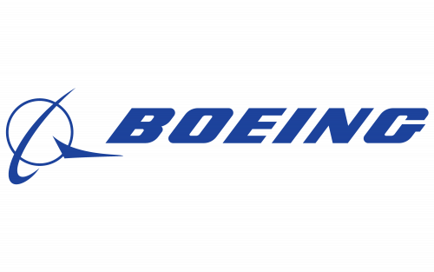
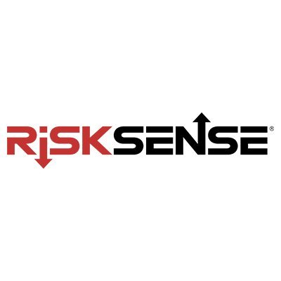
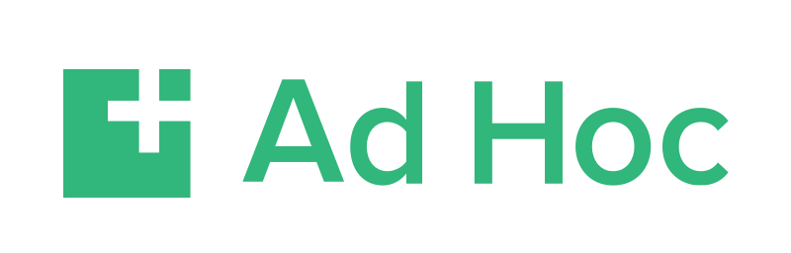
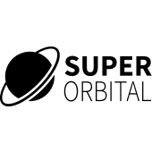
About me
20+ years of Security and Systems Administration/Devops
University of New Mexico
Boeing
RiskSense, LLC
Ad Hoc, LLC
Center for Medicaid and Medicare Services
Department of Veterans Affairs
SuperOrbital, LLC
Notes:
Hello! I’m Demian Ginther. I’m a distributed Systems engineer at SuperOrbital. I’m going to talk today about some supply chain failures and practices in the non-software world that we can learn from and apply to our own work in software. A little bit about me…
I’ve worked in Systems Administration for over 20 years, moving into what is now called Devops, before that word really existed. During that time, I have worn many hats, but security has always been at the core of what I do. I’ve put some of my employers up here, but I’ve done Network Administration, Incident Response, Penetration Testing, Systems Administration, Physical security for a data center, worked for governmental agencies. If anyone wants to hear more about me later, please feel free to say hello!

Slide 3
Who needs a supply chain…
and what is it, anyway?
Non-Software industries with supply chains you may have heard about:
Food, Goods/Commerce, Medical/Chemical, Entertainment, Energy/Utilities
A network of entities - individuals, groups, resources, activities, and technology involved in the creation and sale of a product
The entire system of producing and delivering a product or service
Notes:
What is a supply chain, who uses it, and why do we care about it?
Other than a software supply chain, you probably have heard about supply chains in many other industries, such as food, goods and commerce, medical and chemical, entertainment, energy or utilities… They all share some common concepts, but the overall definition of a supply chain is here - <CLICK 2X> (read the definition)
In the past few years, we have seen a staggering growth in the complexity of software, a huge growth in open source software, and threats have emerged in almost every stage of the system of developing and supplying software. Focus had been on endpoint protection, phishing and other email issues, and other things of that nature. In around 2020, it became painfully clear that the supply chain for the software that everyone was relying on was becoming one of the biggest threats. Of course there had been some supply chain issues before 2020, but the Solar Winds “Solar Burst” attack was one of the first to get this kind of attention.

Slide 4
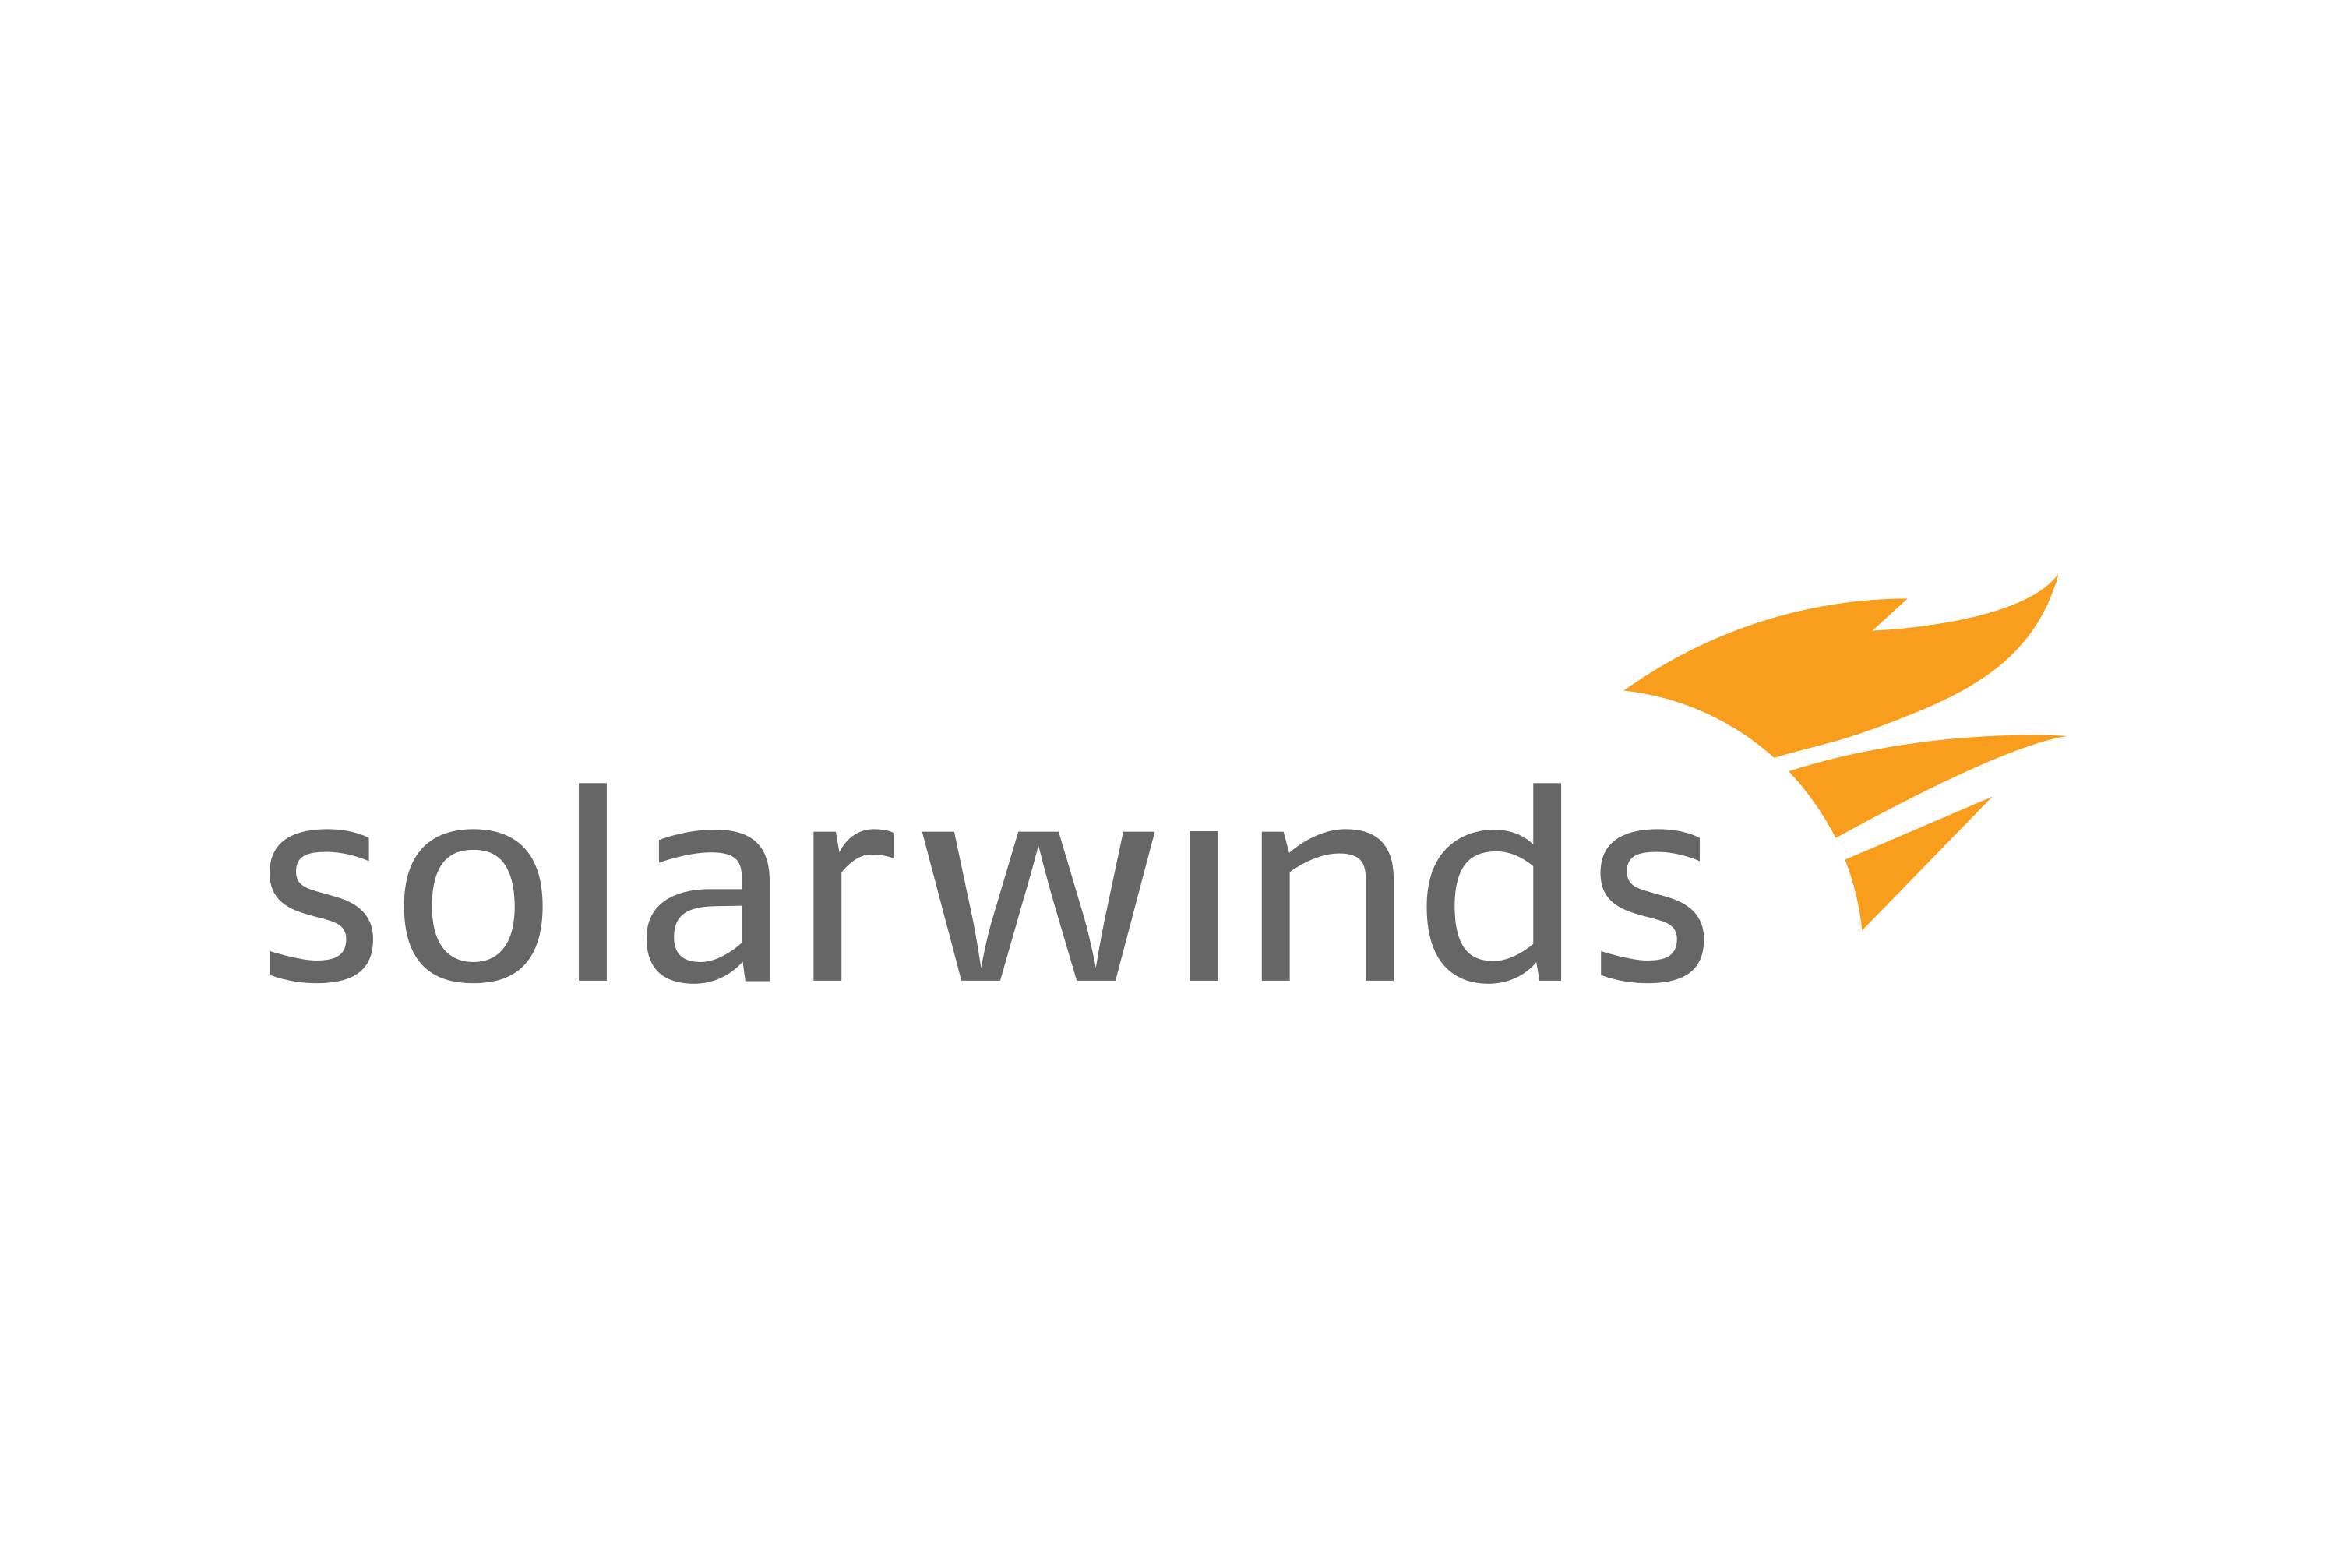
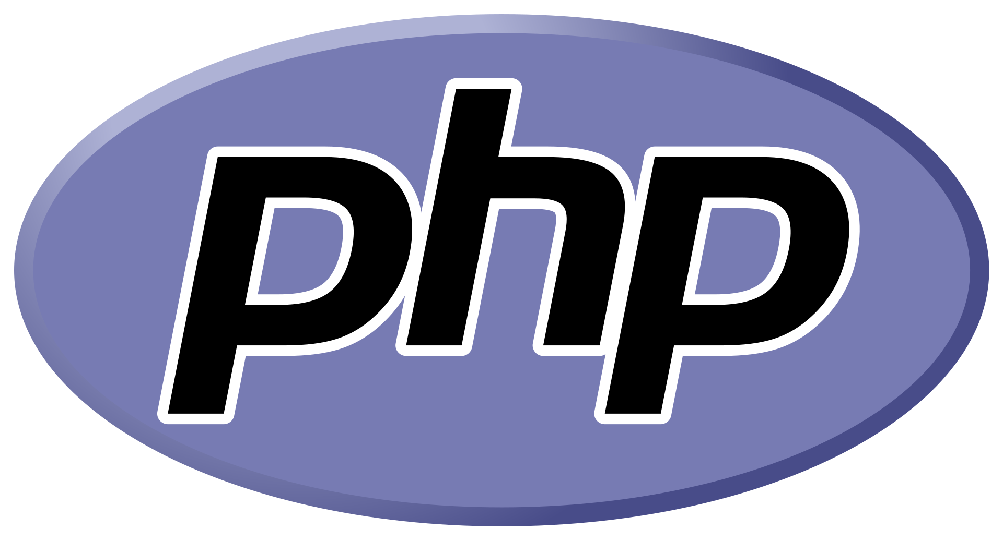

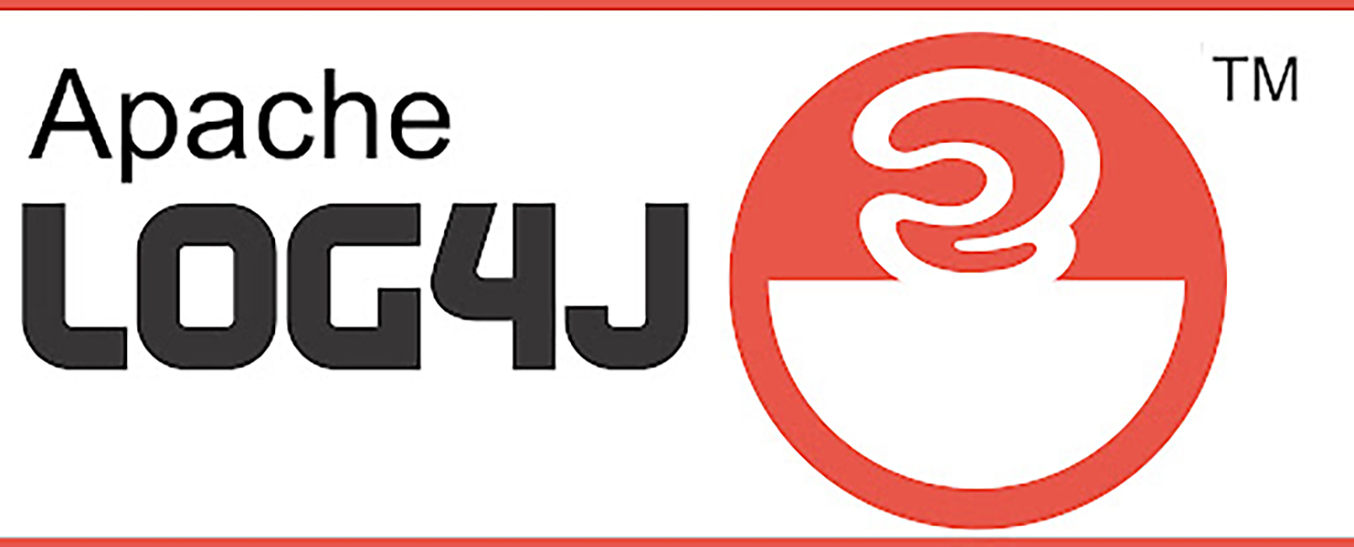
Notable recent software supply chain issues
Solar Winds Orion - 2020
PHP git repository - 2021
Homebrew - 2021
Log4j - 2021
Notes:
<CLICK> Solar Winds - Infection of the system which built commercial software - Dec 2020 - Estimated 18k government entities and Fortune 500 companies, 9 federal agencies, more than 100 other companies. Estimated $90M in economic impact - incident response, forensics, cleanup, PR, fines, lost business (Bitsight/Kovrr estimate).
<CLICK> PHP git repo - early 2021 - self hosted git server was compromised, malicious commits were inserted (forged developer signatures). RCE was added to code. Remediation included moving to 2FA, moving code to Github (maintaining your own infrastructure is hard!) Impacted the credibility and perception of PHP in a lasting way.
<CLICK> Homebrew - mid 2021 - Build system for homebrew casks was discovered to have vulnerabilities which allowed untrusted actors to inject arbitrary code using a pull request to the repository. Highlights the need to have proper pipelines and secure configurations of those pipelines.
<CLICK> Log4j - late 2021 - vulnerability discovered in released code which allowed unsophisticated attackers to fully control servers. Impacted a huge cross-section of software and devices. Showcases the need to know what exactly is in your software, as this was largely a dependency added by other software packages.
The initial incidents that caused these failures were perhaps not preventable, a determined attacker can and will eventually find a hole. The follow-on impacts of these incidents; the overall exposure of information, and costs to remediate them could have been greatly reduced.

Slide 5
Non-Software Supply Chain concepts
Some apply, some don’t.
Traceability and Transparency
Production
Processing
Packaging
Storage
Physical Distribution
Inventory Control
Disposal and Cleanup
Safety and Quality
Logistics
Tracking Distribution
After-Sales Tracking
Notes:
<CLICK>
Traceability - Where did the raw ingredients come from?
Transparency - Who made the product, what are their qualifications, what’s in the product
<CLICK>
Safety and Quality - Storage of product, freshness and proper packaging doesn’t really apply (but safety and quality are relevant concepts to apply)
<CLICK>
Logistics - Pipelines, Resource Utilization
<CLICK>
Tracking Distribution - where is my software deployed? What version of it is deployed? Do I know what dependencies that version has and could I track down that piece of software quickly if I needed to?
<CLICK>
After-sales tracking - Where is the product in use?
<CLICK>
Some that don’t apply as well…
Production, Processing/Packaging, Storage, Physical Distribution, Inventory control, Disposal/Cleanup
Most of these are for wholesale and retail sale of physical goods, and some have parallels you could draw but are mostly not applicable to what I want to discuss.

Slide 6
Traceability and Transparency
“When the lack of transparency in supply chains delays the identification of contamination sources and the root causes of product problems, the economic and public health costs can be considerable.”
-Scott Gottlieb, Statement as FDA Commissioner, March 19, 2019
Ingredients (Dependencies)
Producer (Author)
Location (Deployments)
Problems/Recalls (Vulnerabilities)
Notes:
Think about the last time you ate Romaine Lettuce. Do you know where that lettuce was grown, and what farm produced it? Where did the honey you ate yesterday originate, and why might that be important for allergies, taste, etc? As Scott Gottleib points out in this quote, the public and economic costs of non-transparent supply chains are considerable. If we apply this concept of transparency to the software supply chain… Think about the last time you included a Node or Python package in your project. Do you always go check out their code, and then follow the rabbit hole to look at all the code that they also included in their package? We all know the joke up here about node_modules being heavier than an actual black hole. How long did your last `npm install` take and did you recognize all the packages? How do you determine where you have the products installed, and how do you detect if there is a new vulnerability? How do we make sure we aren’t this xkcd cartoon, where we build this fantastic new product, but somewhere in the dependency chain, there is a project that is under-supported, or possibly vulnerable?

Slide 7
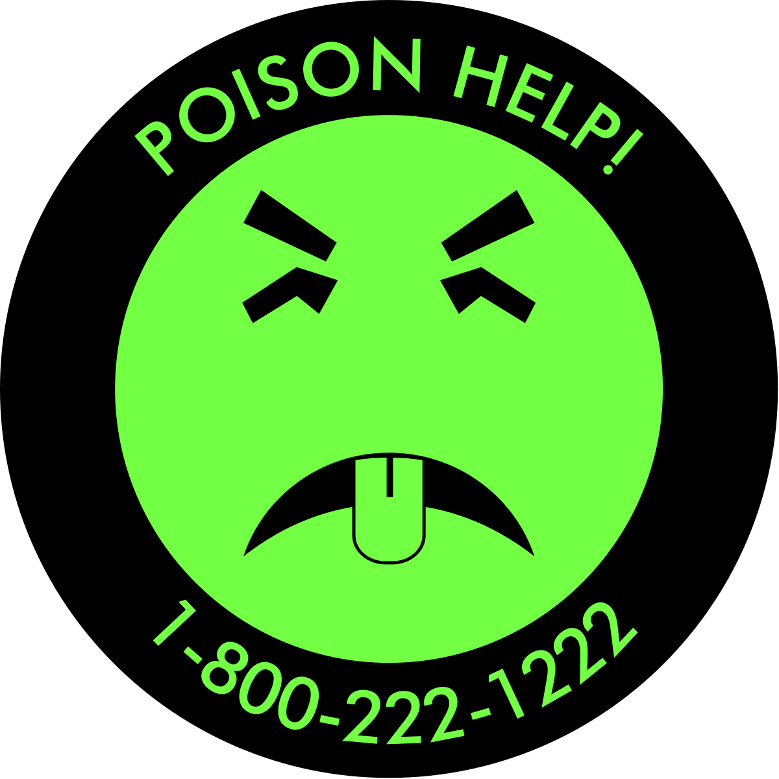
Safety and Quality
Freshness
Packaging
Personnel safety (Labor laws, transport laws)
Safety and Quality apply to software, but in a different way
You or your team, as the developer, are responsible for the quality and safety of your code
Keep ’Toxic Ingredients’ out of your code!
Notes:
In many other industries, safety and quality is about the freshness of the product, whether it was stored correctly, and how outside factors have affected the product; i.e.: rotten food, stale food (infiltration of moisture or other environmental issues), degradation from exposure to light or moisture (particularly with chemicals/medical, but also applicable to others), or in the case of entertainment, transportation/logistics, the safety of the workers or truck drivers, etc. Much of that does not apply to software, luckily. Software doesn’t go bad or have an expiration date. These concepts DO apply to software, <CLICK> however, much of the safety and quality of software comes down to the previously covered traceability, and the ability of YOU, the developer, to make sure that you are auditing and reviewing what you put in your code, <CLICK 2X> and that you are not including `toxic ingredients` in your code. Who here remembers Mr. Yuk? Maybe I’m showing my age here… We’ll talk later about the supply chain concepts that can help you make sure you’re on top of this.

Slide 8
Logistics
Continuous Integration Pipelines
Jenkins
Argo Workflows
TeamCity
CircleCI
Github Actions
AWS CodePipeline
Traversing the supply chain…
Assembly
Storage
Shipping
Tracking
Code Repositories
Github
Gitlab
BitBucket
Artifactory
Sourceforge
Container/SBOM/Signature Registries
DockerHub
Github Package Registry
Gitlab CR
Google Artifact Registry
Amazon ECR
Azure CR
Harbor CR
Red Hat Quay
Continuous Deployment Pipelines
Jenkins
Argo Workflows
AWS CodeDeploy
TeamCity
CircleCI
Application Visibility
Datadog
Raygun
Dynatrace
AppDynamics
New Relic
Notes:
In other industries, we have to worry about many more physical concerns than in the software supply chain, but we have many corresponding concerns. You can think of software supply chain logistics as “How does my software get from the developer’s keyboard, into the code repository (you ARE using one of those, right?), <CLICK 3X> through a series of tests, <CLICK 5X> to an eventual code merge, and then, how does my software get distributed to the end user, <CLICK 2X> how does the end user know it is safe and secure, <CLICK 2X> how does it get deployed, and how do I know where it is deployed and how it is performing?” We aren’t driving any trucks or ships here, but there is a ‘pipeline’ that is analogous to the physical world.
Here are come common tools, both Open Source and paid, used for these analogous processes, it’s not a full list, but these are tools I’ve used and thought were good quality. Whatever tools you choose, you must make sure to incorporate some best practices…
Security at every step
- Scan during builds
- Store code securely - Ensure repositories are secure and contributors are vetted and security aware
- Regularly scan old builds/SBOMs for new vulnerabilities - new vulns are discovered all the time, and that’s just the ones that we know about
- Scan software before deployment. Use an admission controller in K8s to deny untrusted containers. Ensure that you know what is running and where
- Keep a record of what you’ve deployed, and what version, so that you can find it in a hurry

Slide 9
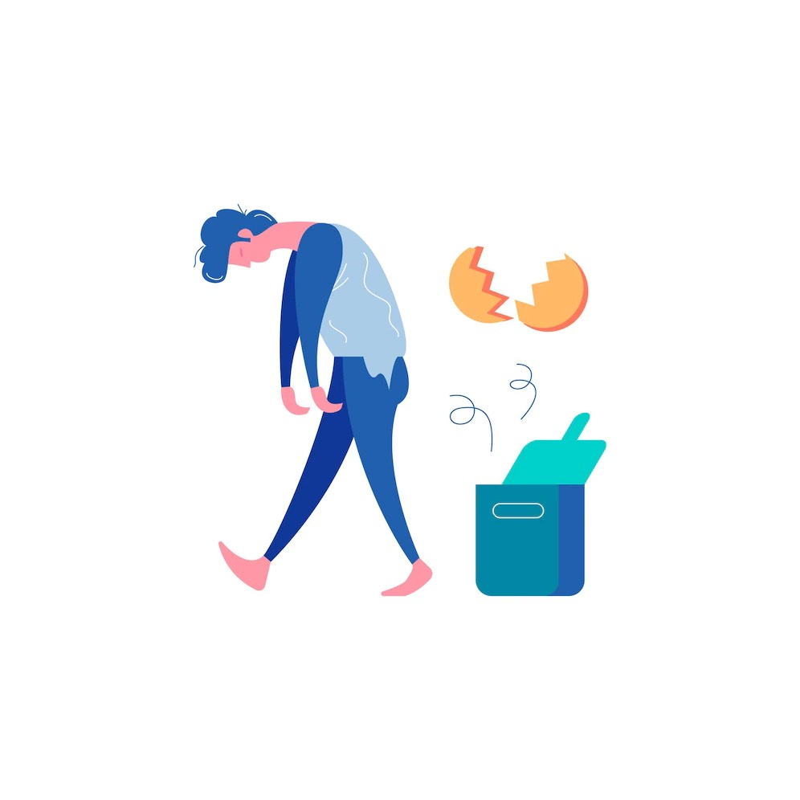
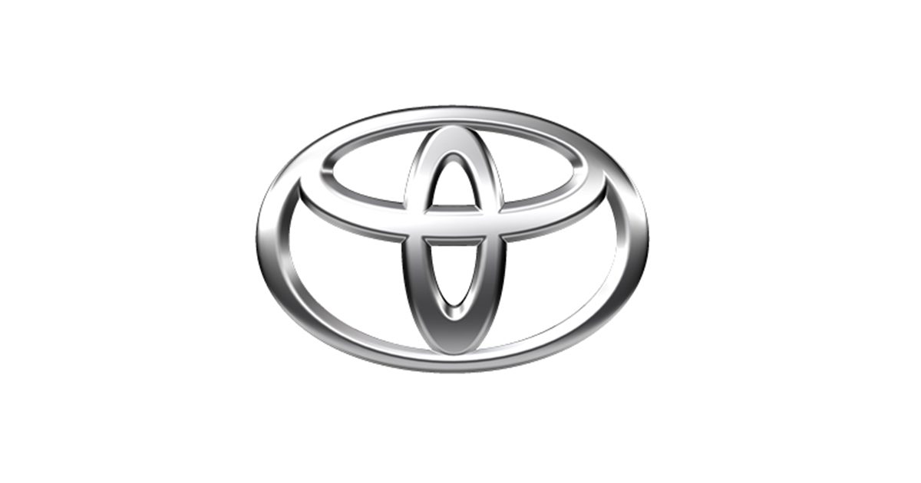

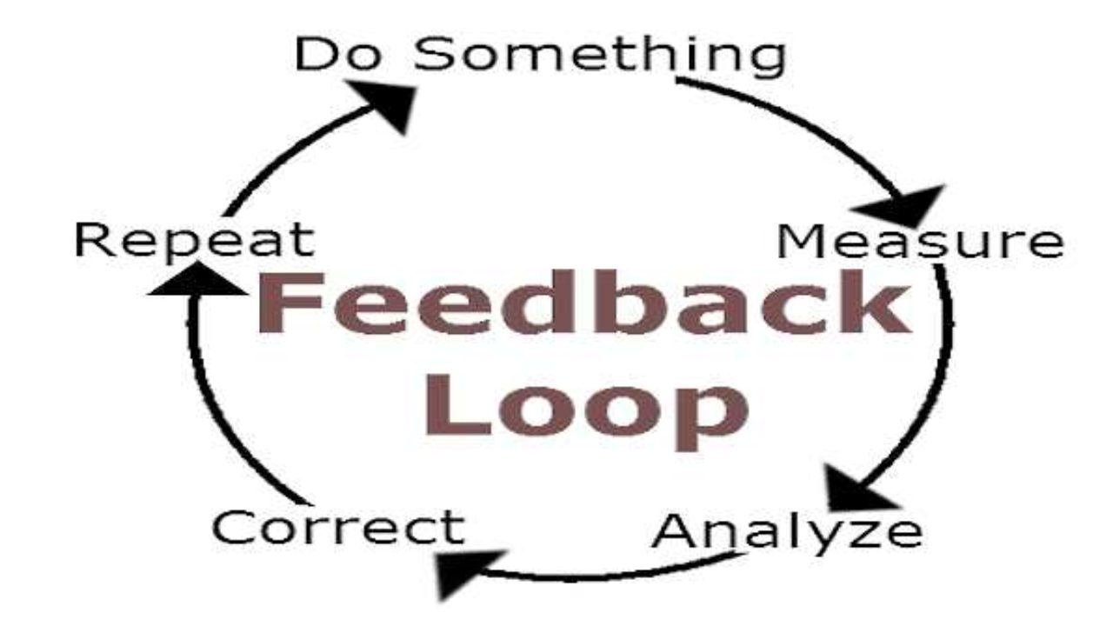
Failure
Image by macrovector on Freepik
Best way to learn?
Kaizen
“Continuous Improvement”
Agile
The “Eureka Moment”
Image by Dall-E
Notes:
Alright, let’s talk about failure. I love failure. In the moment, it’s not so great, and obviously it can have dire consequences in some cases, but even so, I think it is the absolute best way to learn. Toyota uses the concept of Kaizen, or ‘continuous improvement’ to drive their business. In order to have continuous improvement, you must be open to failure, and then identify mistakes and work toward developing solutions. In many ways, this is what drives Agile software development. Iterate, determine what didn’t work, plan your next moves, and move to your next iteration. Failure drives creativity in problem solving, gives incentive, the eventual solution when all the pieces finally fit together, that ‘Eureka moment’, is gratifying. So let’s look at some failures…

Slide 10

Romaine Lettuce
E. coli outbreak, November 2018
Multi-state outbreak of E. Coli
Total loss $280-350M
Source: E. Coli in the Romaine Lettuce Industry: Economic Impacts From the November 2018 Outbreak. July, 2021. Kristin Diesel, Rachael E. Goodhue, Richard J. Sexton, and Ashley Spalding. https://kiesel.ucdavis.edu/Full%20Report.pdf
Improvements?
Traceability
Transparency
Blockchain?
Notes:
Now let’s talk about why blockchain is going to save the world… In November of 2018, there was an outbreak of E. coli in the U.S. and Canada which was linked to romaine lettuce. 62 people in 16 states were infected over roughly two months. The source of the outbreak was identified, and the produce was recalled. On the surface, this looks like a success. Economic analysis shows, however, that the impact of this outbreak could have been lessened, had there been more transparency and traceability for the affected produce. Had there been a system in place that allowed consumers to know where their food was grown, it could have potentially reduced the time to determine the source of the lettuce, the scope of the recall, and the subsequent drop in overall romaine lettuce sales. For example, Walmart Food Safety teams can take as much as 7 days to trace where food sold in their store has originated, because it is all tracked on paper, and has to be tracked through farm, processing, packaging, distribution, and sales. Walmart has since implemented a blockchain based tracking system which has reduced the time to mere seconds in many cases.
Lessons we can apply to software:
The ability to determine where your dependencies came from is vital in detecting and reacting to potential problems
Blockchain has it’s uses, but let’s not be too optimistic about it. :)

Slide 11

Peanut Corporation of America
Salmonella, 2006-2009
At least 714 infections, 9 dead
Intentional coverup
Most companies rely on the ‘One-up-One-back’ approach
Insufficient!
Whole chain visibility is necessary
Notes:
Between 2006 and 2009, the Peanut Corporation of America released peanuts contaminated with Salmonella into the food supply. There were over 700 infections, 9 people died, and there was an intentional coverup by the corporation’s high level executives. The eventual fallout of this was federal prosecution of PCA officials on a 76 count indictment, with successful convictions. During the process, some companies were notified that they had contaminated peanuts, but there was a lack of full visibility for the entire chain of supply, not only because of intentional tampering in the reporting of the contamination, but also because most companies rely on a “one-up-one-back” approach. Companies know only their direct supplier and their direct customer. So some companies purchased the contaminated peanuts from a third party, without knowing that the original source of the peanuts was the Peanut Corporation of America. This meant that they continued to sell the products even after the recall, because they didn’t have sufficient visibility into the entire supply chain. We, as software developers, have no such excuse. If we were selling peanuts, we have the technology enabling the ability to track those peanuts to the individual customers, and the peanut farmer can know the name of the person who purchased each batch of peanuts, the customer can know who farmed the peanuts, and each party can know the chain of supply in-between.
Lessons we can apply to Software:
It’s not enough to know what your dependencies are, you must also know what your dependencies’ dependencies are!
Humans can be pretty evil.

Slide 12

Knowing where your dependencies are from
And where their dependencies are from…
Automate the creation of an SBOM for each deliverable
Anchore Syft (multi-language)
kubernetes-sigs/bom (Kubernetes)
cyclonedx/bom (NodeJS)
Others: https://github.com/awesomeSBOM/awesome-sbom
Sign your SBOMs
Sigstore Cosign
Admission Controllers / Automated checks before running
Notes:
It’s turtles all the way down…
SBOM: Software Bill of Materials. What does the software (or container, or helm chart, etc) contain? What pieces of software are used in the creation of your software?
Ensure that your chosen tool creates a multi-level SBOM. It is not enough to know what your own software dependencies are, you must also know what the dependencies of your dependencies are.
In order to lighten the burden of creating, storing and signing your SBOMs, you must use an automated process to create your SBOM, store it, and sign it.
Why sign your SBOM? In order to ensure the integrity of your SBOM and to be sure it has not been modified since it was created.
And finally, if you have an SBOM and a digital signature, use an admission controller or some other automated check to ensure that your system cannot run an unsigned or unchecked deliverable!

Slide 13
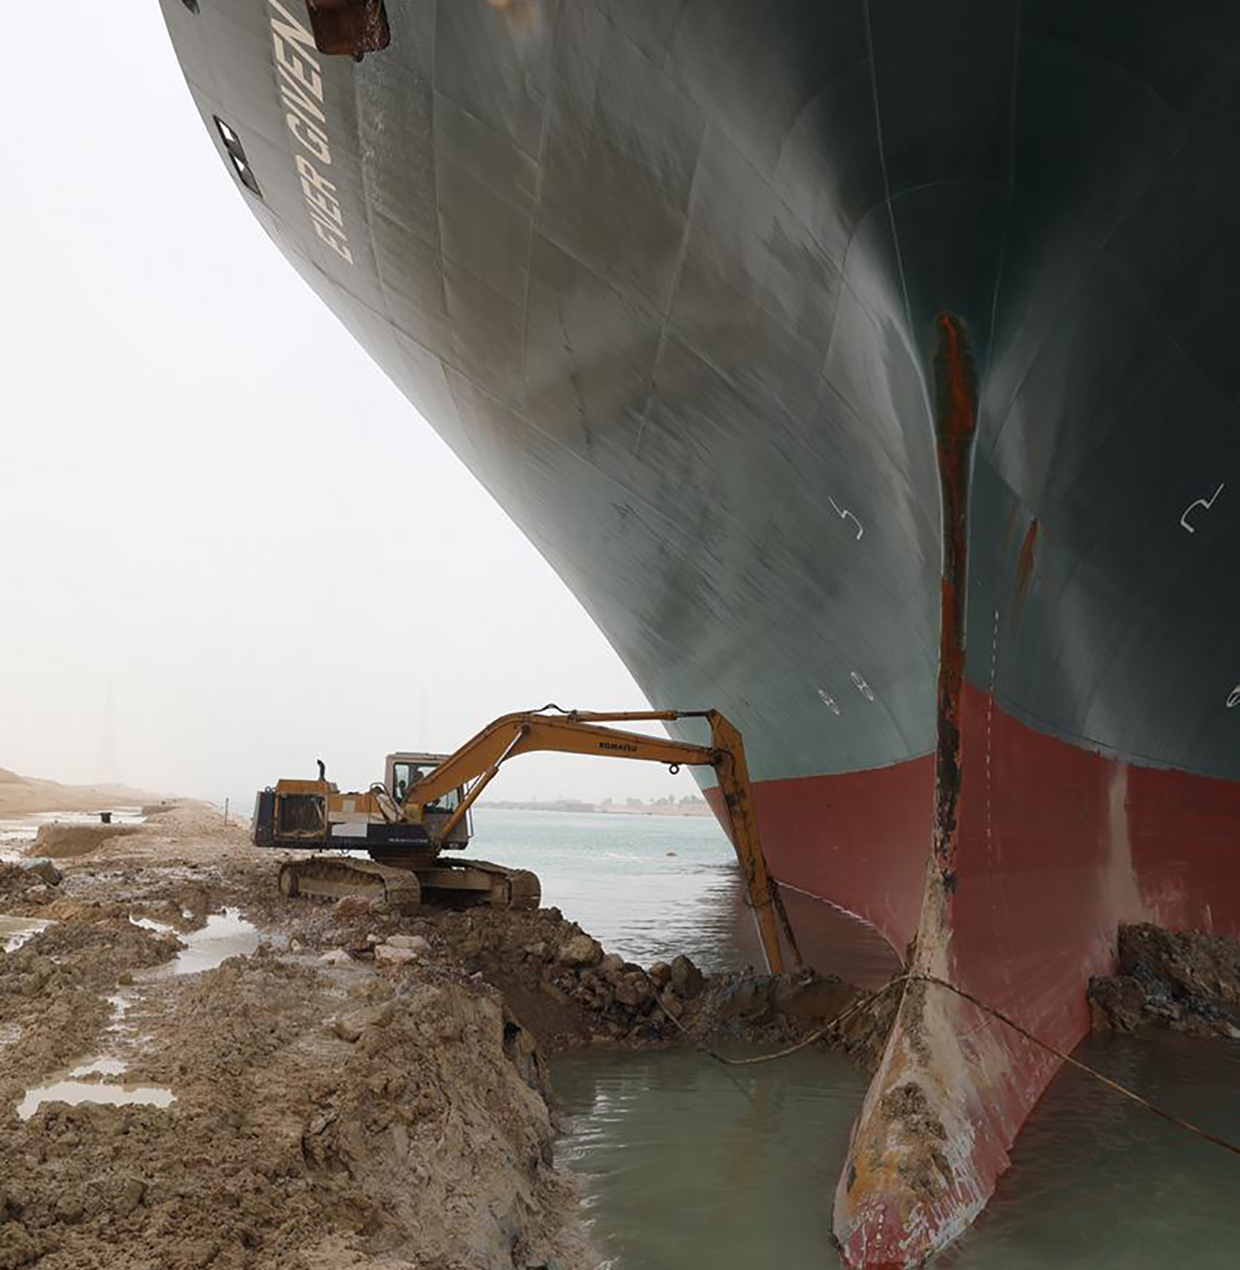
Ever Given
Suez Canal, March 2021
Estimates of $60B in trade affected
Plan B not so good
6 day bottleneck of resource created months of detrimental effects
Notes:
On March 23, 2021, a ship named the Ever Given got stuck in the Suez Canal. Plan B for ships that need to traverse the canal is to embark on a voyage around the Cape of Africa, which is a dangerous trip, and could add weeks to the transport time of any goods. This wasn’t the best plan B, but Additionally, many of the products loaded onto the container ships could possibly have been shipped by plane, which, depending on the monetary value of the goods, could have mitigated the losses experienced. Poor inventory and tracking of goods on the ship meant that suppliers and customers were essentially in limbo regarding whether their goods were affected, and when the goods might arrive.
Lessons we can apply to Software:
Have infrastructure and resources available to support a Plan B, and possibly a Plan C, if your Plan B might not be tenable
Have a plan in place to mitigate the ‘ripple’ effects of an outage in your development pipelines

Slide 14

Plan B
And Plan C, Plan 9…
Infrastructure for your pipelines
Multiple regions
Self-healing
Performance visibility
Monitoring and alerting
Logging
Practice and use Chaos
Human processes can be slow
Know what happens when things are down
Notes:
In order to ensure that your supply chain can be resilient to disruptions and unforeseen events, you should dedicate at least some thought to redundancy. If budget allows, you should definitely use multiple regions in your cloud provider (or if you are on-premise, multiple data centers, or lacking that, redundant power and cooling. If your supply chain pipeline breaks down, have a plan in place for how you will track and trace your software.
Kubernetes can assist with redundancy and self-healing.
Make sure you have monitoring and alerting in place for resource utilization, errors, etc.
Logs will assist in troubleshooting and maintaining the integrity and traceability of your code pipeline.
Logs and monitoring are not enough, however, since they are indicators of what _has_ already happened. In order to avoid problems before they happen, you will need to develop a system which _verifies_ everything.
And if you take the time to develop a Plan B, you must practice that Plan B (or Plan C, D, etc.). If your human processes are too slow; maybe you cannot get around the Cape of Africa fast enough to prevent goods from spoiling… your plan may not be helpful in an emergency.
And if you want to develop really resilient systems, look into using Chaos engineering to help you know what happens in each part of your supply chain when things fail.

Slide 15
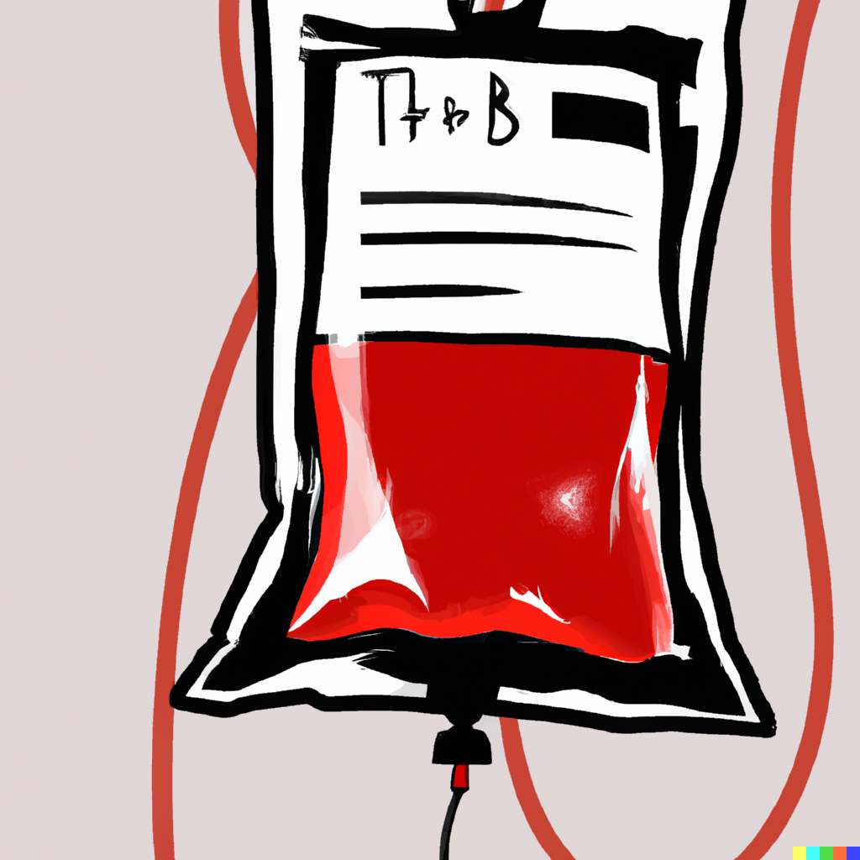
Transfusion blood supply
Study - 2011
https://www.ncbi.nlm.nih.gov/pmc/articles/PMC3096861/
48% of records had errors before 2002
Traceability was >99% after 2005
How? Automation!
Notes:
In a retrospective study of a hospital’s blood transfusion system in Hospital de Navarra in Pamplona Spain, it was determined that previous to the implementation of an automated system for identification of patients and blood transfusion materials, there was an error rate of 48.0%. This was due to manual processes for identification being used.
An electronic system for identification of patients and blood transfusion materials was introduced, which led to a massive increase in traceability and a massive error reduction. This also led to better outcomes for end users (patients).
Lessons -
always always automate your system. Manual systems are impossible to maintain, audit, or rely on
Add checks to ensure you’re using the right deliverables/products

Slide 16
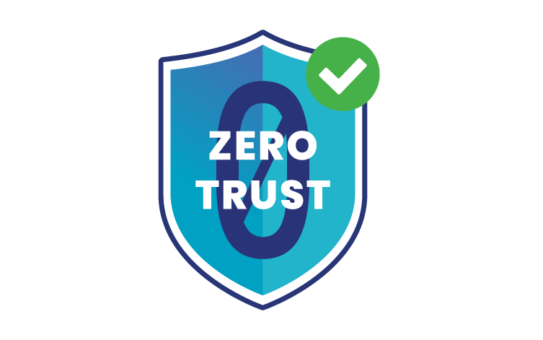
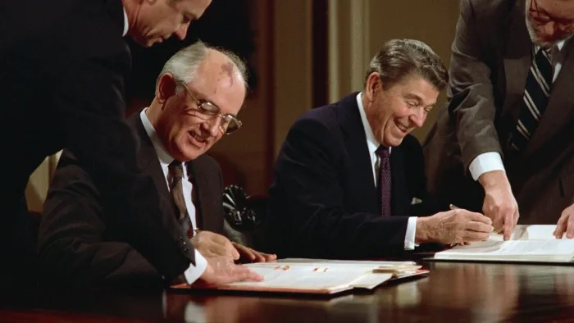
Never Trust, Always Verify.
Trust but Verify
Notes:
I’m sure you’ve heard of the old proverb “Trust, but verify.” I’d much rather hear you say - Never trust, always verify.
Verification is the cornerstone of a good security program and the basis for a ‘zero-trust’ architecture. I won’t get into the complete zero-trust architecture conversation here because we don’t have enough time, but some good points to include here are -
- Zero trust architecture is the strategy which eliminates implicit trust, and instead, validates and verifies at every step.
- use strong authentication
- least access policies
- validate your application behavior, don’t just assume it will behave the way it says on the tin
- use this same validation and verification for all components of your system, including your supply chain

Slide 17

Automation
Automate the easy stuff
Version bumps in dependencies
Vulnerability scans
SBOM creation, and future use
Admission controllers
Notes:
You cannot have a security system which depends solely on human beings to manually review scan results or to detect vulnerabilities. You also cannot have a system which relies entirely on computer automation. (yet, anyway! Maybe ChatGPT can analyze and fix our vulnerabilities someday!) Someone has to look at the logs, vulnerability scan output, and your team must take action to remediate. Preferably, use separation of duties to have another team which verifies that remediation has occurred.
Automate the easy stuff
- Version bumps in dependencies. Use one of the many tools out there to analyze your dependencies and alert you when there are updates. Have it make a PR if you can. Automate tests that will verify functionality of the software (TDD is excellent for this purpose!) to reduce the need for your team to manually test when versions change.
- Automated scans. Use a vulnerability scanner in your CI pipelines. Make sure that a vulnerability discovered in your dependencies will prevent a merge. This is difficult sometimes for developers. Cultivate an attitude of ‘security is everyone’s responsibility’. If you can surface problems early and often, your team will have an easier time, and your software will be more secure.
- SBOM creation. Create and store SBOMs with container images. Develop automation which will detect new vulnerabilities in those SBOMs. Make sure you can know exactly where you’re using a container and the version of that container, quickly and easily, in the event that a new vulnerability is detected in an older image
- Admission controllers - If you’re using containers/K8s it is easy to implement an admission controller which will ensure validation and verification of digital signatures, vulnerability scans, etc.

Slide 18

In conclusion…
The ability to determine where your dependencies came from is vital in detecting and reacting to potential problems
It’s not enough to know what your dependencies are, you must also know what your dependencies’ dependencies are!
Add automatic checks to ensure you do not run unsigned/un-checked code
Have infrastructure and resources available to support a Plan B, and possibly a Plan C, if your Plan B might not be tenable
Have a plan in place to mitigate the ‘ripple’ effects of an outage in your development pipelines
Automate everything!

Slide 19

Image Credits
Some images generated with the assistance of Dall-E 2
Failure image: Freepik/Macrovector
xkcd.com
Photo of the Ever Given: Associated Press
Plan 9 poster: Tom Jung
Reagan/Gorbachev photo: Bettmann Archive/Getty Images
Various logos: Relevant Official Websites
Zero Trust logo: Tigera.io
Mr Yuk: UPMC Children's Hospital of Pittsburgh

